Slide 1


Slide 2
Time Management

Slide 3
7 langkah yang dapat Anda terapkan
Help everyone to learn faster

Slide 4
Bagaimana mengatur hari-hari Anda untuk menjadi produktif.
Help everyone to learn faster

Slide 5
Perangkap Time Manajemen terbesar
Help everyone to learn faster

Slide 6
Apa yang harus dikerjakan dan kapan harus memastikan pekerjaan Anda selesai
Help everyone to learn faster

Slide 8
The 2000 year old “secret”
Help everyone to learn faster

Slide 9
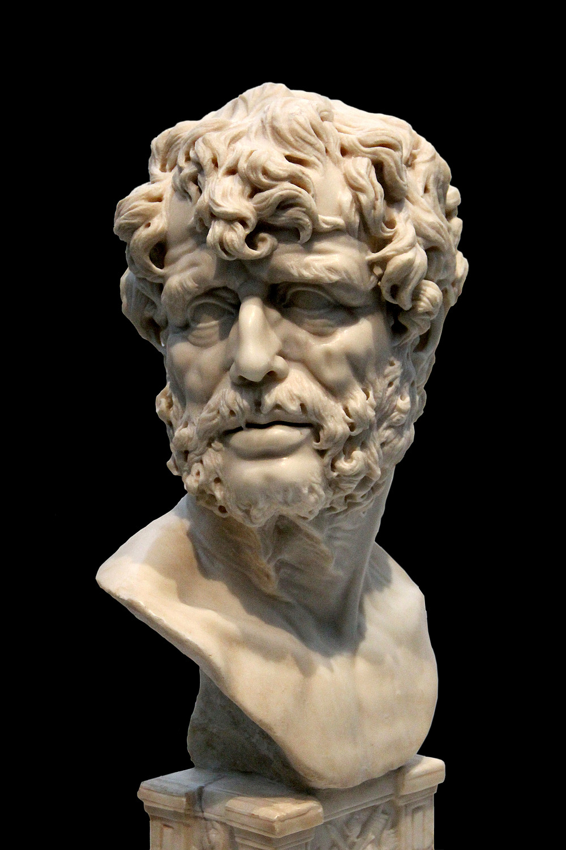
“It is not that we have a short time to live, but that we waste a lot of it.
Life is long enough and a sufficiently generous amount has been
given to us for the highest achievements if it were all well-invested.”
Help everyone to learn faster

Slide 10
Apa artinya waktu Anda diinvestasikan
dengan baik?
Help everyone to learn faster

Slide 11
kebijaksaan
kesehatan
uang
hubungan
Ketenangan pikiran
Menginvestasikan waktu dengan baik
adalah
mengelola waktu dengan baik
Help everyone to learn faster

Slide 13
PERANGKAP MANAJEMEN WAKTU
YANG HARUS DIHINDARI
Help everyone to learn faster

Slide 14
Berpikir “real time” apa yang
akan kamu kerjakan..
Buang-buang tenaga..
..dan buang-buang waktu
Help everyone to learn faster

Slide 15
“THAT’S BORING..”
ROUTINE BRING
FREEDOM
RITUAL
SEBUAH FRAMEWORK YANG ANDA GUNAKAN UNTUK HARI ANDA,
AND TO DECIDE WHAT TO WORK ON..
Help everyone to learn faster

Slide 16
tugas Anda adalah membuat kerangka kerja (framework) yang dapat Anda gunakan berulang kali
Help everyone to learn faster

Slide 17
Let’s jump into the 7 specific things you can do to be
more productive
Help everyone to learn faster

Slide 19
7 Langkah Menjadi Produktif
Help everyone to learn faster

Slide 20
Rutinitas Pagi Anda
Help everyone to learn faster

Slide 21
RUTINITAS
Akan membuat Anda bersemangat
Help everyone to learn faster

Slide 22
RUTINITAS
“Kita pikir untuk mencapai lebih banyak,
kita perlu berbuat lebih banyak.
tetapi pada kenyataannya untuk mencapai lebih banyak,
kita perlu menjadi lebih,
ketika Anda menjadi lebih,
Anda mencapai lebih banyak dengan melakukan lebih sedikit”
Help everyone to learn faster

Slide 23
RUTINITAS
IT WILL HELP YOU BECOME MORE
.. karena income, jarang melebihi pengembangan diri
Help everyone to learn faster

Slide 24
Silence (meditasi)
Affirmations (afirmasi)
Visualization (visualisasi)
Exercise (latihan)
Reading (membaca)
Scribing (menulis)
RUTINITAS
Help everyone to learn faster

Slide 25
RUTINITAS
EXERCISE
(latihan)
Help everyone to learn faster

Slide 26
READ YOUR
PURPOSE
RUTINITAS
Baca Tujuan Anda
Help everyone to learn faster

Slide 27
RUTINITAS
VISUALIZE
visualize success
Memvisualisasikan kesuksesan
.. dan visualisasikan diri Anda memanfaatkan hari Anda sebaik-baiknya
(apa yang kamu lakukan dan bagaimana?)
Help everyone to learn faster

Slide 28
RENCANAKAN RUTINITAS PAGI ANDA UNTUK LEBIH PRODUKTIF
RUTINITAS
Help everyone to learn faster

Slide 30
GETTING IN THE ZONE
Help everyone to learn faster

Slide 31
KONSENTRASI PENUH DALAM APA YANG ANDA KERJAKAN MEMBUAT PEKERJAAN ANDA TERASA RINGAN
THE ZONE
Help everyone to learn faster

Slide 32
TAPI KEBANYAKAN KITA JARANG MENGALAMI KEADAAN INI
THE ZONE
Help everyone to learn faster

Slide 33
ANDA PERLU BEKERJA DALAM KURUN WAKTU YANG TIDAK TERGANGGU
THE ZONE
Help everyone to learn faster

Slide 34
THE ZONE
BUY AN ELECTRONIC TIMER
Help everyone to learn faster

Slide 35
45 MENIT
SAMA SEKALI TIDAK ADA GANGGUAN
THE ZONE
Help everyone to learn faster

Slide 36
KERJAKAN DENGAN PENUH FOKUS
SAMA SEKALI TIDAK ADA GANGGUAN
THE ZONE
..and take
Good breaks!
Help everyone to learn faster

Slide 37
IT DOESN’T MATTER
HOW LONG YOU WORK FOR.
ONLY HOW MUCH YOU GET DONE
THE ZONE
Help everyone to learn faster

Slide 38
WORK IN CHUNKS
OF UNINTERRUPTED TIME
THE ZONE
BEKERJA DALAM WAKTU YANG TAK TERGANGGU
Help everyone to learn faster

Slide 40
WHAT TO
WORK ON
APA YANG HARUS DIKERJAKAN
Help everyone to learn faster

Slide 41
WORK ON THINGS
THAT MOVE YOU
MEASURABLY CLOSER TOWARD
YOUR GOALS
WHAT TO
WORK ON
BEKERJA PADA HAL-HAL YANG MEMBUAT ANDA
LEBIH DEKAT MENCAPAI TUJUAN ANDA
Help everyone to learn faster

Slide 42
APAKAH INI SESUATU
YANG “HARUS” SAYA LAKUKAN?
WHAT TO
WORK ON
Help everyone to learn faster

Slide 43
ATAU APAKAH YANG SAYA KERJAKAN
MEMBERIKAN
HASIL YANG DAPAT DIUKUR
WHAT TO
WORK ON
Help everyone to learn faster

Slide 44

“Business has only 2 functions:
marketing and innovation.
Everything else is a cost.”
WHAT TO
WORK ON
Help everyone to learn faster

Slide 45
WHAT TO
WORK ON
WHAT ACTIVITIES PAY ME
THE HIGHEST RETURN
Help everyone to learn faster

Slide 47
MAKING A PLAN
Help everyone to learn faster

Slide 48
BUAT RENCANA LANGKAH DEMI LANGKAH UNTUK MENCAPAI TUJUAN UTAMA ANDA
MAKING A PLAN
Help everyone to learn faster

Slide 49
KESALAHANNYA ADALAH KETIKA SETIAP LANGKAH DALAM RENCANA TIDAK MEMBUAT KITA SECARA SIGNIFIKAN LEBIH DEKAT MENUJU TUJUAN
Step 2
Step 1
Help everyone to learn faster

Slide 50
MAKE YOUR
GOALS FOR YOUR WEEK
MAKING
A PLAN
Help everyone to learn faster

Slide 51
AND A DAILY
TO DO LIST
MAKING
A PLAN
Help everyone to learn faster

Slide 52
WHAT IS THE
ONE THING
I CAN DO THAT WILL
PAY BE THE
HIGHEST RETURN?
MAKING
A PLAN
Help everyone to learn faster

Slide 53

“Staying busy is
Laziness, because you
stay busy to avoid
something you don’t
want face.”
MAKING
A PLAN
Help everyone to learn faster

Slide 54
AM I INVENTING
THINGS TO DO TO
AVOID THE IMPORTANT?
MAKING
A PLAN
Help everyone to learn faster

Slide 55
DO I REALLY NEED
TO DO THIS?
MAKING
A PLAN
Help everyone to learn faster

Slide 56
MULAI KELOLA WAKTU ANDA
MAKING
A PLAN
Help everyone to learn faster

Slide 58
Aturan
80/20
Help everyone to learn faster

Slide 59
SPEND AT LEAST
80% OF YOUR TIME ON YOURSELF
The Other
80/20
Rule
Help everyone to learn faster

Slide 60
SPEND AT LEAST
80% OF YOUR TIME ON YOURSELF
The Other
80/20
Rule
Batu
Kerikil
Pasir
Air
Help everyone to learn faster

Slide 61
JADIKAN SEBAGIAN WAKTU FOKUS ANDA UNTUK YANG LAIN
The Other
80/20
Rule
Help everyone to learn faster

Slide 63
The Time Management Sheet
Part 1
Help everyone to learn faster

Slide 64
The Time Management Sheet
Part 2
Help everyone to learn faster

Slide 66
MANAJEMEN WAKTU
Help everyone to learn faster

Slide 67
MITOS
“MERUBAH HIDUP”
Help everyone to learn faster

Slide 68
PERUBAHAN TIDAK TERJADI SEMALAM
Help everyone to learn faster

Slide 69
QUICK RECAP...
Help everyone to learn faster

Slide 70
1. SET UP YOUR
MORNING RITUAL
WHAT WILL GET YOU FEELING AT YOUR BEST?
Help everyone to learn faster

Slide 71
2. HOW DO YOU
WANT TO
STRUCTURE YOUR
WORK DAY?
Help everyone to learn faster

Slide 72
3. WHAT
ACTIVITIES PAY
YOU THE
HIGHEST
RETURN?
Help everyone to learn faster

Slide 74
Terimakasih
Help everyone to learn faster

